Slide 1
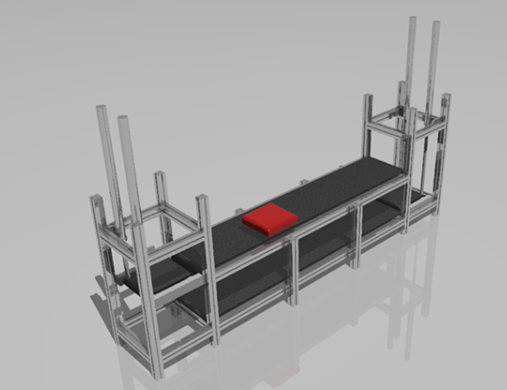
Conveyor control system, visualization and Indusoft
Group members:
Ilir Kokollari
Zhilun Chang
Tobiloba Ero
Wilppu Ahonen

Slide 2
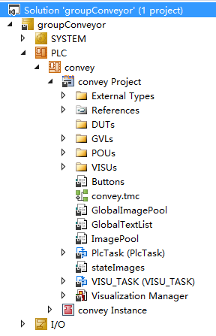
Twincat project
Visualization
Functions
Function Blocks

Slide 3
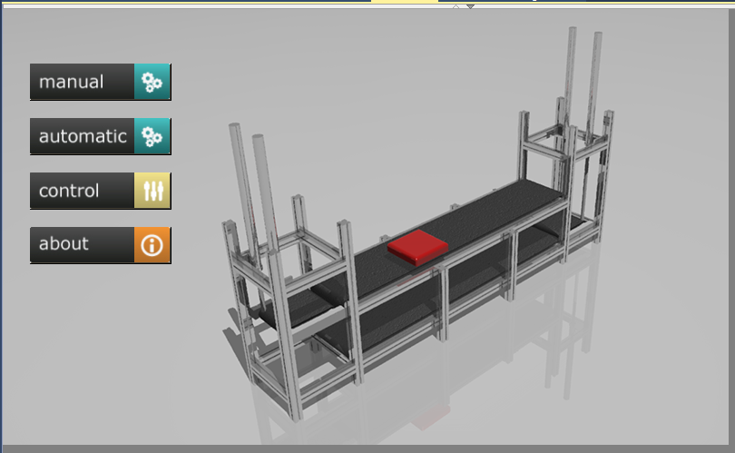

Slide 4
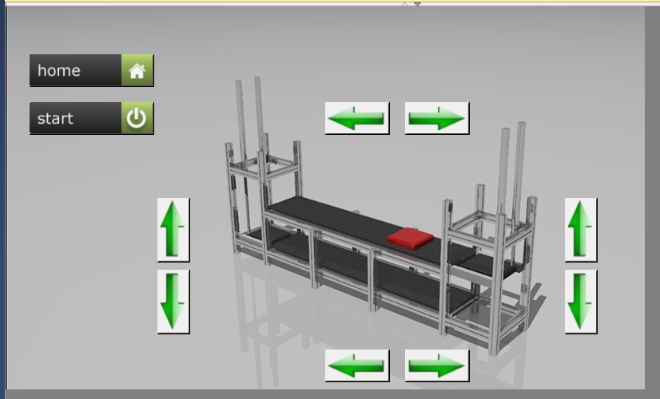

Slide 5
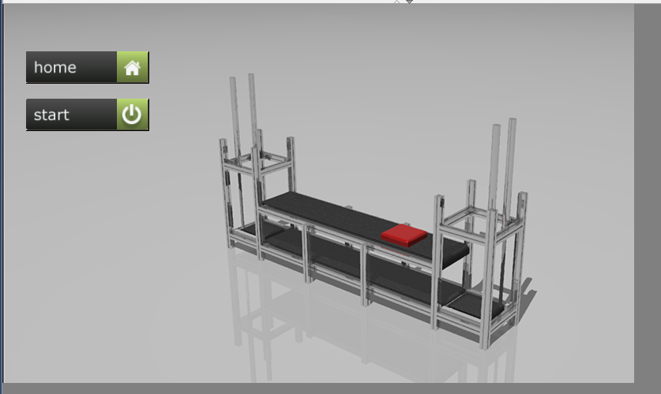

Slide 6
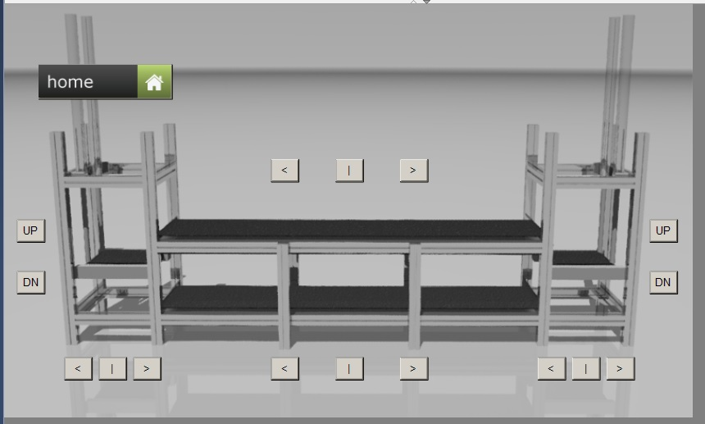

Slide 7
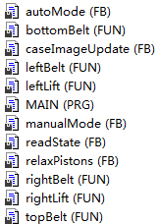
(FUN)Functions & (FB)Function blocks
Functions
Function blocks

Slide 8
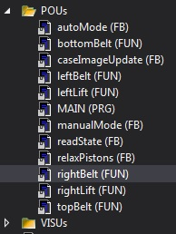
(FUN)Functions at state.
Defining or reading state of output.
Creating possible ouputs depending on state
Executing the output.
Why?

Slide 9
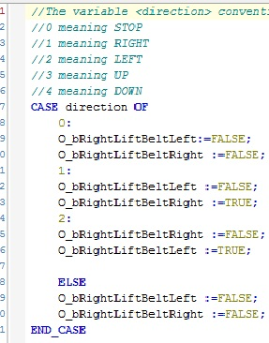
(FUN) Defining or reading
Defining or reading status
eg. Right lift belt.

Slide 10
(FUN) Creating possible outputs.
Creat possible output from initial status.
eg. variable directions.
CASE
( 0 = STOP ,1=RIGHT ,2=LEFT).

Slide 11
(FUN) Executing outputs.
Execute output from defined status.
eg.Case 1 to go right
CASE direction OF
1:
O_bRightLiftBeLeft := FALSE ;
O_bRightLiftBeRight := TRUE ;

Slide 12
(FUN) WHY ?
A bit Complex but easy Algorithm
Also easy to check incase of ERROR IN CODE

Slide 13
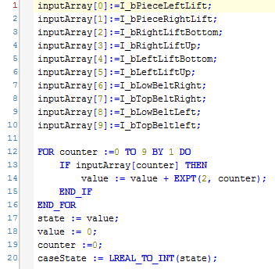
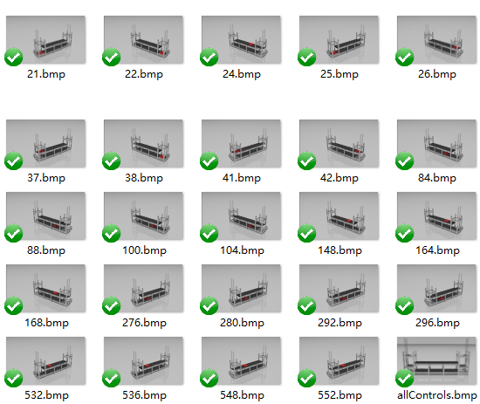
readState(FB)
Great idea→10 bits
24 different stages
0~(2¹⁰-1)

Slide 14
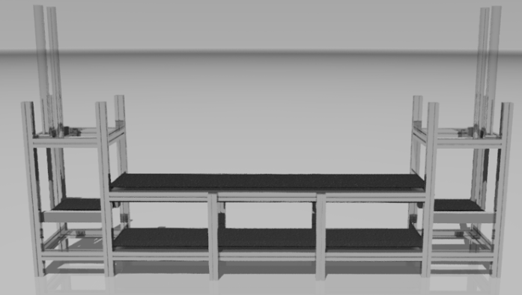

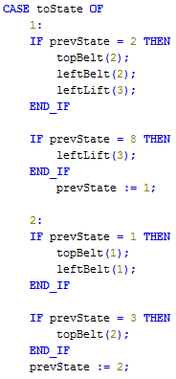
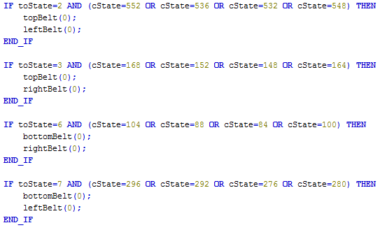
manualMode(FB)
1
2
3
4
……
8
7
6
5

Slide 15
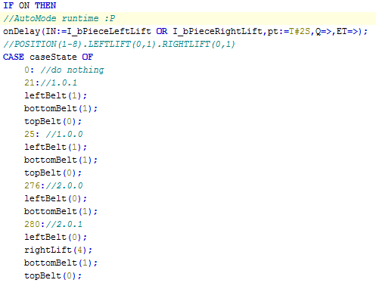

autoMode(FB)
8 positions
Begin at any
place
……

Slide 16
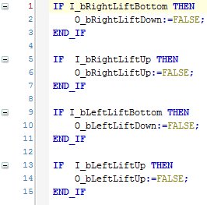
relaxPistons(FB)
Simple but useful
To make the value of lift
outputs changing to 0
automatically

Slide 17
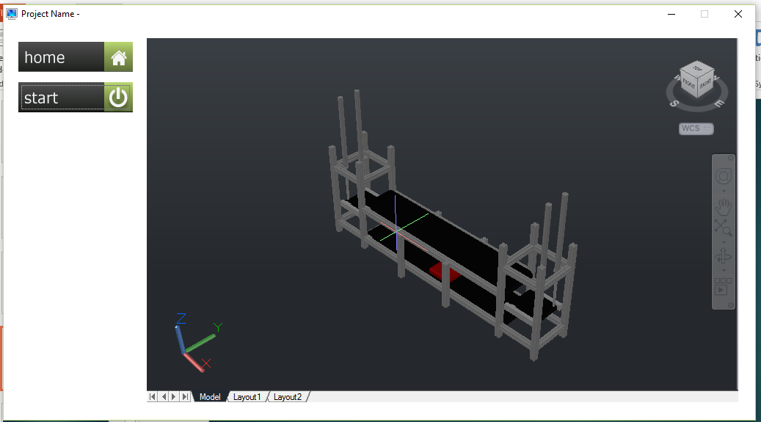
Indusoft
Tag integration
ActiveX
3d model in embedded system

Slide 18


Short comments of used programs and tools
Autodesk Inventor – 3D modeling
Visual studio shell - Twincat
GIMP – Image editing
Indusoft

Slide 19

Thanks

